Slide 1
Genre Discovery Grid
Team Utópico

Slide 2
Team members
Will McAuliff
Mark Baylis
Kevin Whiteside
Héctor L. Santana-Quintana

Slide 3
The Concept
Music Discovery
Soundcloud and Twitter
Underground Music
Mixtapes
Memes
# for Tagging
Genre Discovery Grid: A curated grid of music genres, displaying relevant results from Soundcloud and Twitter.
Notes:
Our group was interested in building an app based on music discovery.
Today, two of the most popular networks for music and conversation are Soundcloud and Twitter. Soundcloud is social platform that anyone can post their music to. People use Twitter to share the latest underground music, mixtapes, and memes related to music hosted on Soundcloud.
Conversations on both of these platforms use the same convention for tagging related content: the hashtag.
Our app is a curated grid of music genres, and uses the hashtag to display Soundcloud music, as well as the Twitter conversations around them.

Slide 4
Live Demo
Tweet using #vaporwave
Notes:
Now, Hector's going to do a live demo.
If anyone here has a twitter account, feel free to tweet using the hashtag "#vaporwave". If you do, you just might make an appearance in our presentation.

Slide 5
Technologies Used
Twitter Search API
Soundcloud Search API
Soundcloud Embed Player
Foundation CSS
Mooch for Oauth authentication

Slide 6
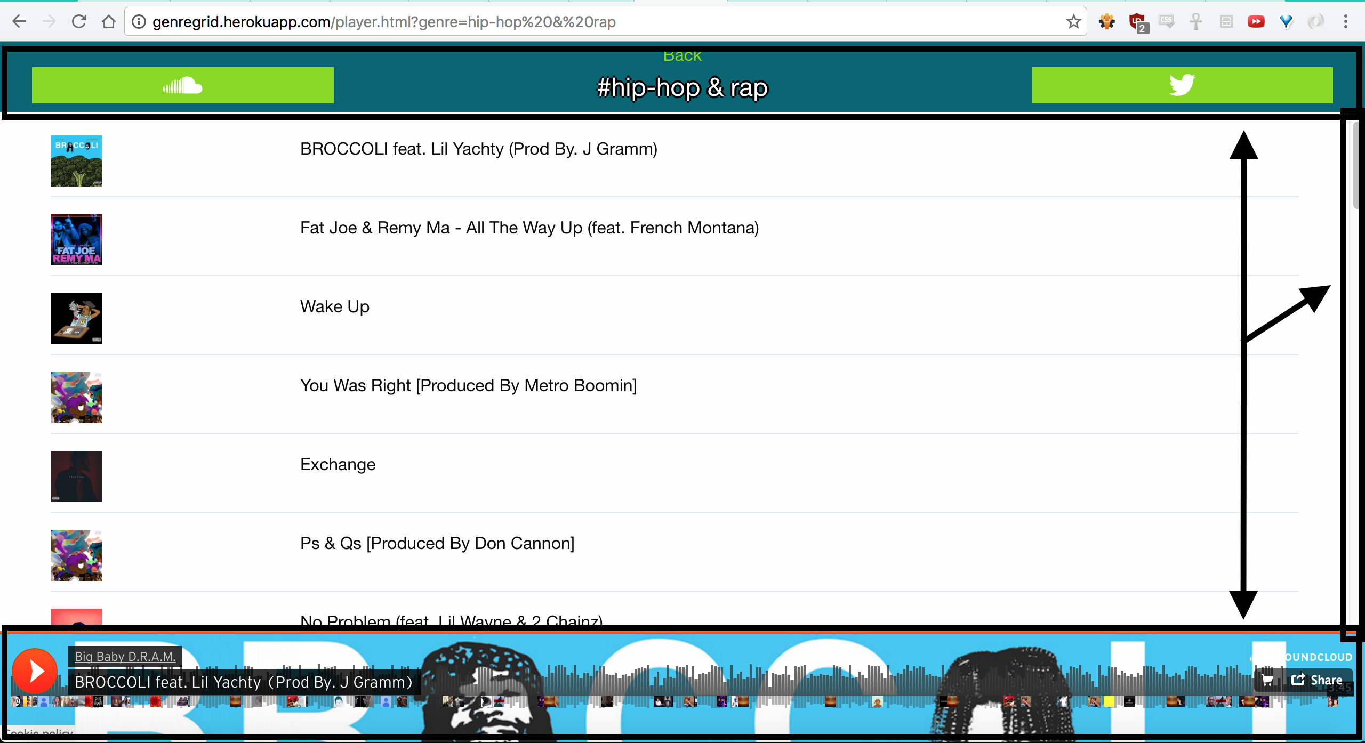
Persistent Navigation with Content Scrolling
Notes:
For the player page of our app, we knew we wanted to have a persistent navbar at the top and bottom of the screen, and limit scrolling to the content in the center of the screen.

Slide 7
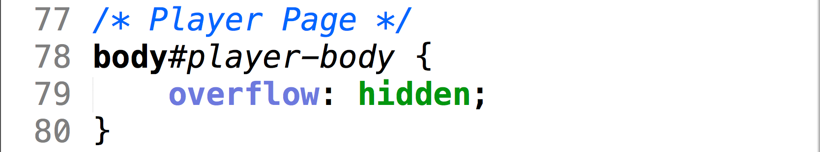

Persistent Navigation with Content Scrolling
Notes:
The first step is to set the overflow property on the body to hidden. This removes the scroll bar from the side of the page.
Next, we add an id to the content div, and specify that the overflow-y property should scroll.

Slide 8
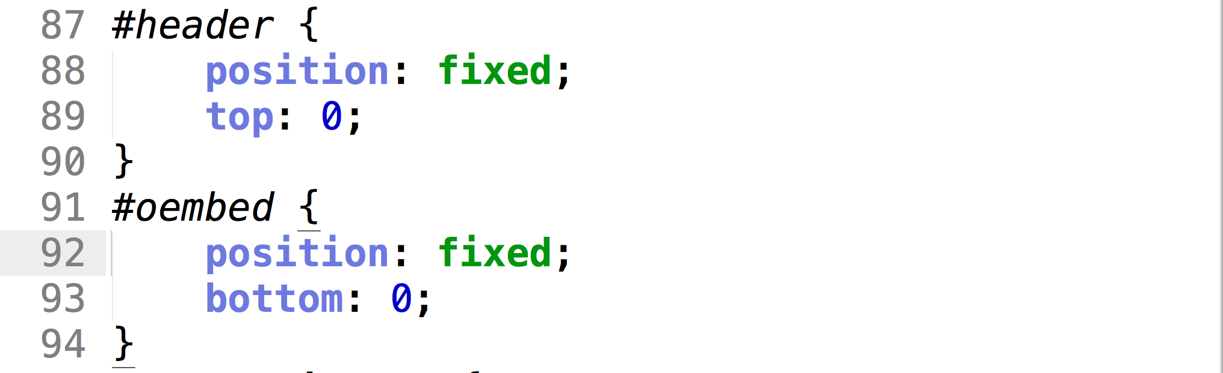
Persistent Navigation with Content Scrolling
Notes:
The next step should look familiar: we use the position property to keep the header and footer fixed to the top and bottom of the screen.

Slide 9
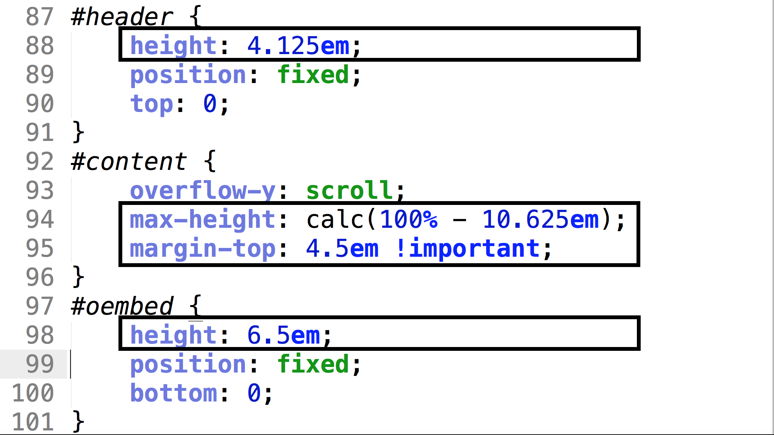
Persistent Navigation with Content Scrolling
4.125
+ 6.5
----------
10.625em
Notes:
Here’s the final step:
We specify heights for both the persistent header and footer. In the case of our app we have a header that has a height of 41/8 ems, and a footer at 6.5ems.
The middle-content’s maximum height is calculated dynamically, by saying it should be 100% minus the total of the height from the header and footer.
Finally, we add a margin to the top of the middle-content, so that it is pushed down from the header.

Slide 10
Q&A
Thanks For Your Time!

